Slide 1
All about search
John clayton
http://codemonkeylabs.com/

Slide 2
Tl;dr
Your users want search
Search is hard – very hard
Unless you really, really need something custom, try to find a tool that fits your need with the least amount of friction
The Stack Exchange data dump is a fantastic dataset for experimenting
You have 3 options:
Roll your own search platform
Use a self-hosted search software
Use a service

Slide 3
Why search
If users can’t find something, it may as well not exist
Help users find what they are looking for while keeping them on your site
Users expect search to work like Google – if it doesn’t, that’s what they’ll use instead
LIKE ‘%cat%’ doesn’t scale and is inflexible
Indexes do not help searching for substrings

Slide 4
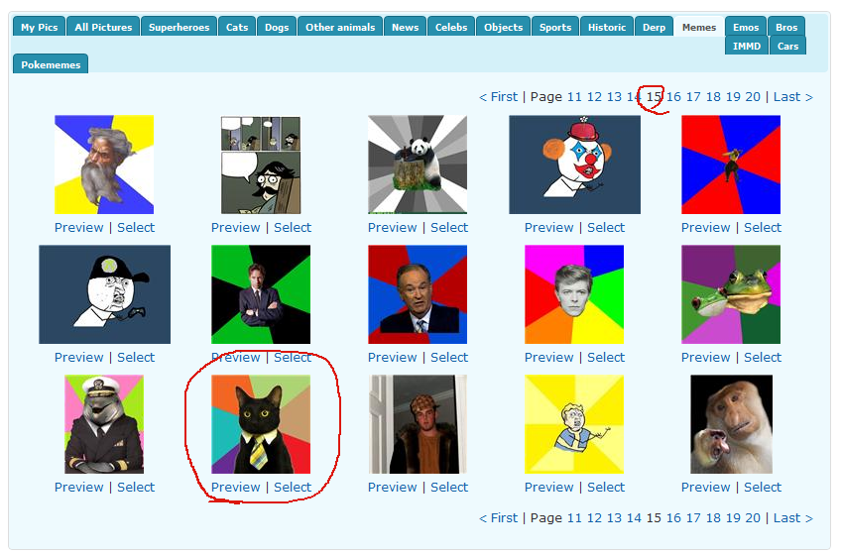
Before search
Wade through 15 pages before finding the business cat template (probably gave up at page 4)

Slide 5
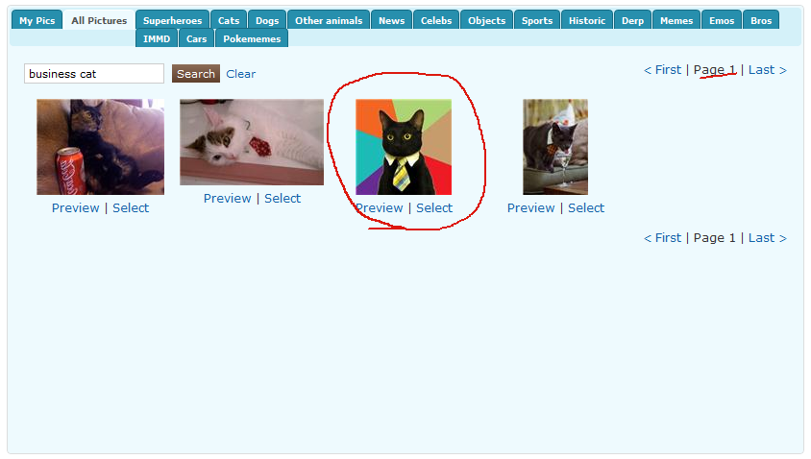
After search
Instant gratification!

Slide 6

Option a: SQL Full Text Search
Your database might already support full text search:
MySQL >= 5.0
Sql Server >= 2005
PostreSQL >= 8.3
Pros
You might already have it
Cons
Not much flexibility
Database-specific queries
Could negatively affect app/database performance

Slide 7

Option 1: Roll your own
Java Lucene is considered the gold standard of indexes
Lucene.NET is a direct port of Java Lucene
Pros
Ultimate flexibility
Excellent performance
Cons
You have to understand how search works
You have to implement everything – indexing, querying, file structure, replication, backup, etc.
It’s literally a line-by-line port, so it uses Java’s conventions
Turbulent project history

Slide 8

Option 2: Host software
Solr is a Java-based Lucene service
Pros
Newer than Lucene.NET (3.4 vs 2.9)
Software you can stand up on your own server and simply configure and use via HTTP
Out of the box it provides highlighting, faceting, clustering, rich document parsing (e.g., Word, PDF), geospatial search, replication, distributed search, and much more
Cons
Servers require administration
Indexes have to be configured up front
It’s Java
.NET clients aren’t great

Slide 9

Option 3: use a service
IndexTank is a hosted service for indexing and searching data
Pros
Dead simple – just sign up and start using it
Supports faceting, geospatial queries, highlighting, and custom sorting & scoring
Good .NET client
Free for 100K documents, reasonable beyond that
Cons
Limited visibility & documentation on making a good index
Services introduce an external dependency

Slide 10
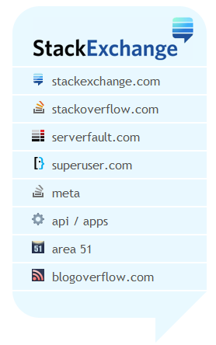
Wat do?
Spend plenty of time evaluating the different options
Take advantage of the Stack Exchange data dump – 4.7GB of compressed text data to experiment with
Remember to consider the whole cost – development time, servers, administration, etc.

Slide 11
Resources
Lucene: http://lucene.apache.org/
Lucene.NET: http://incubator.apache.org/lucene.net/
Solr: http://lucene.apache.org/solr/
IndexTank: http://indextank.com/
Stack Exchange Data Dump: http://bit.ly/se-datadump

Slide 12

Demo time

